Slide 1


WELCOME TO OUR CLASS
Class : 3D
Teacher: Cao Thi Dat Ai Mo Primary School

Slide 2

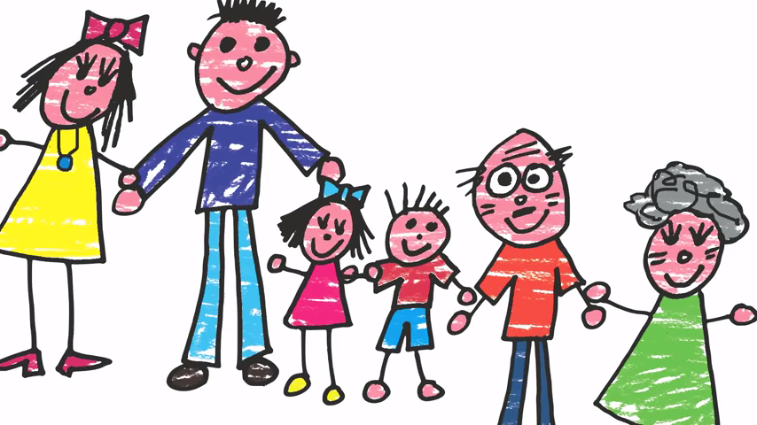

Mommy and daddy. Sister and brother. Grandma and grandpa. My family. Mother and me. Daddy and me. My family. I love my family. Sister and me. Brother and me. My family. I love my family

Slide 3
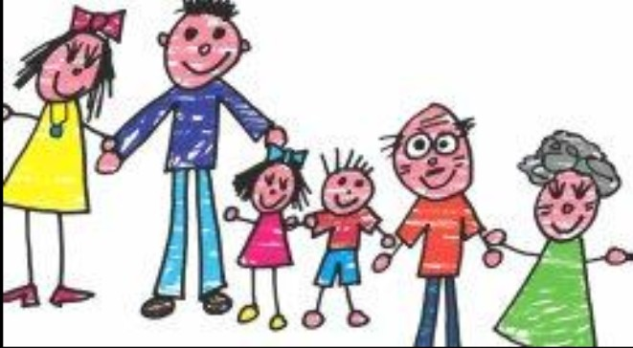
Family

Slide 4
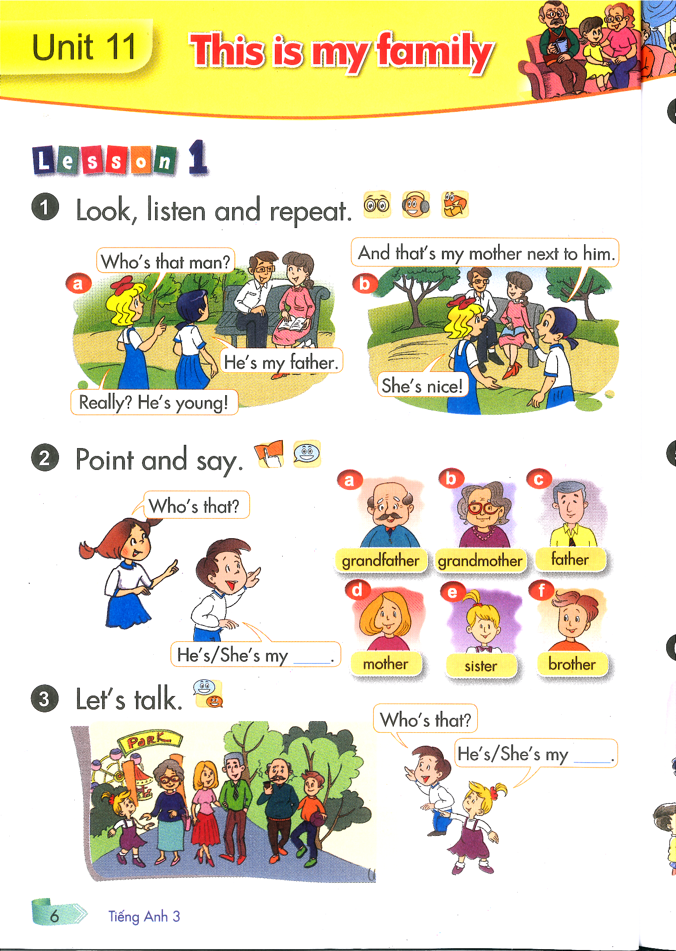

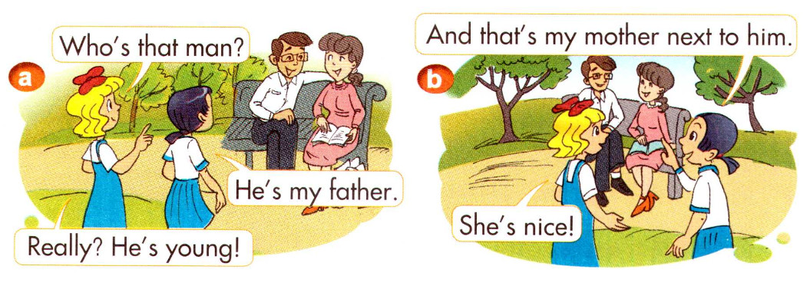
Father:
Mother:
Father:
Bố
Mother:
Mẹ

Slide 5
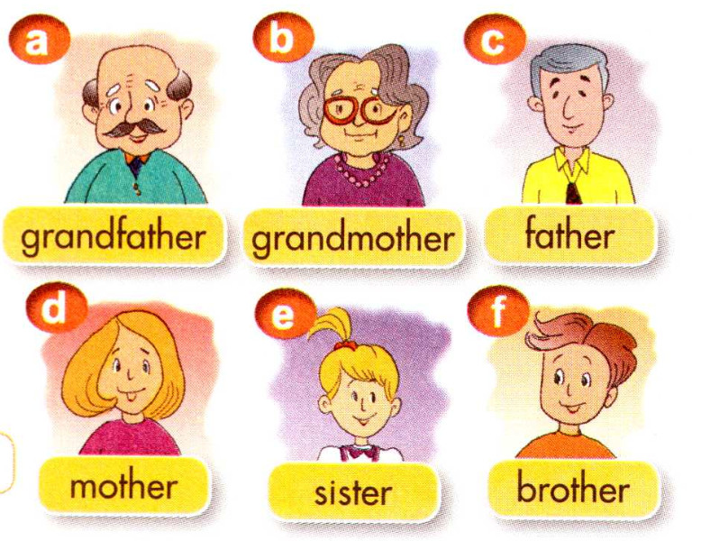
ông
bà
Chị/ em gái
Anh/ em trai

Slide 6

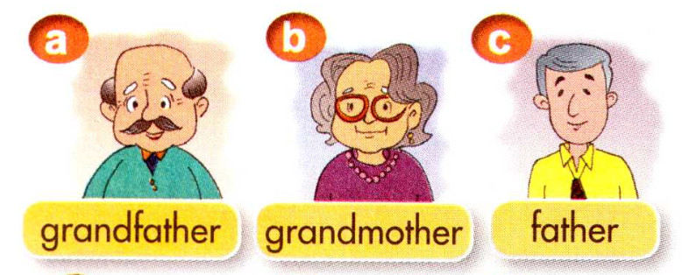
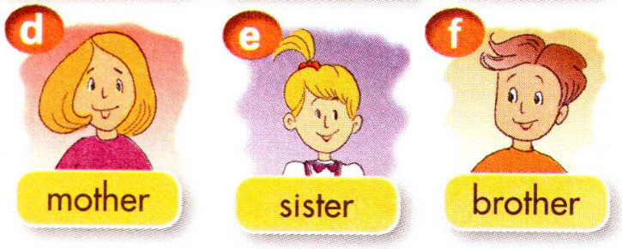
Matching
Chị/ em gái
Bố
ông
Anh/em trai
Mẹ
Bà

Slide 7

He’s my father.
She’s my mother.

Slide 9

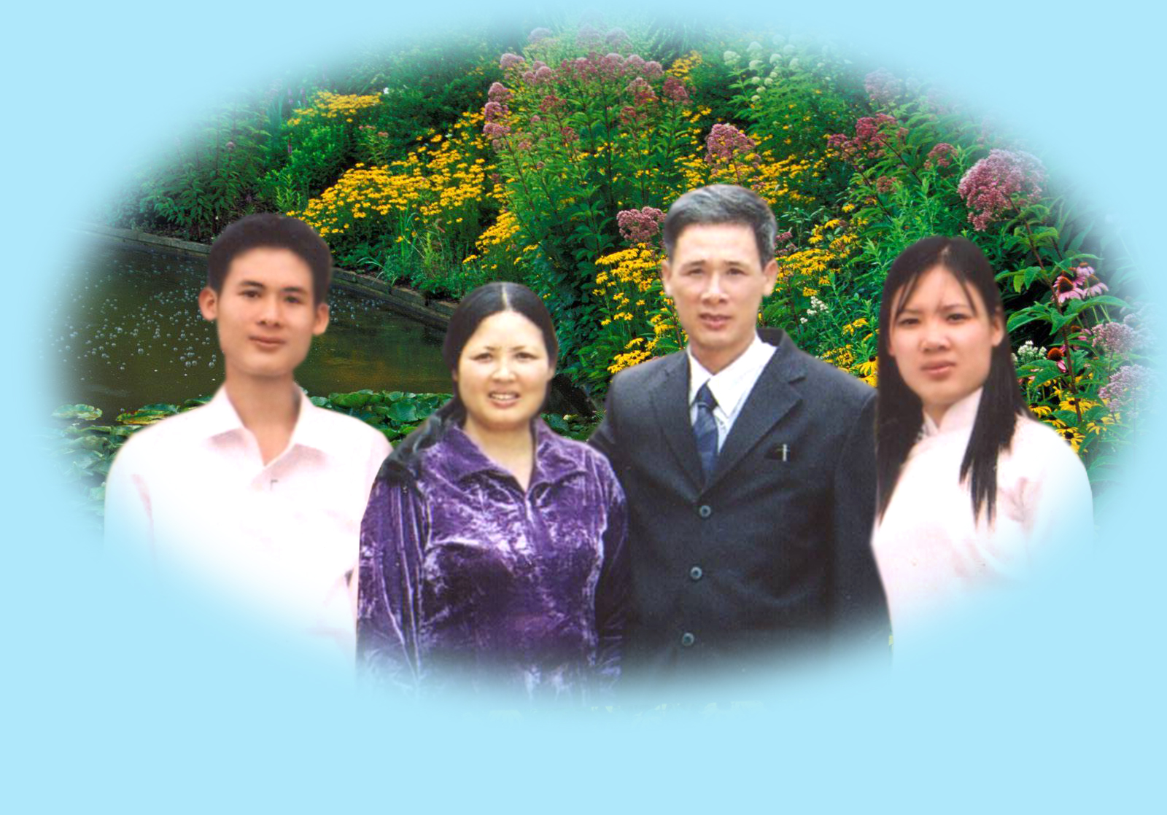

Slide 10

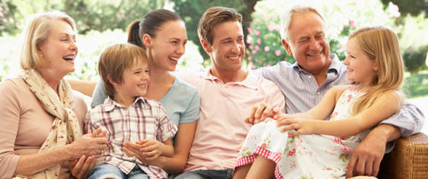
A happy family
Happy, happy, happy father.
Happy, happy, happy mother.
Happy, happy, happy children.
Happy, happy, happy family.

Slide 11

Homelink
Learn by heart about family words,
Practice to introduce about your famliy members

Slide 12




